Slide 1
Glow Byte Hackaton 2021
Team name: “Mental”
Case 2
Objective: to improve the scoring system for individual loan applications by adding data from other sources to the application

Slide 2



Current scoring system
Can I have a loan? I filled in the application
Nope
But why?
The Mercury is in retrograde

Slide 3
Road map
Novel data
Automation
Adding data to the application info from different sources
Scripts for data automatic extraction
1
2
3
4
5
Data preparation
Merge
Machine learning
Identification of parameters significant for creditworthiness from the combined data set
Filtering and transformation

Slide 4
1
Choose data for the update
What kinds of data do we have?
Data kind | Database
Credits | postgresql
Salaries | neo4j
Insurance | mysql
Interview transcripts | mongodb

Slide 5
01
02
Extracted data
03
04
Postgresql
4 tables and applicsation
MySQL
23 tables
Neo4j
2 tables
MongoDB
1 file

Slide 6
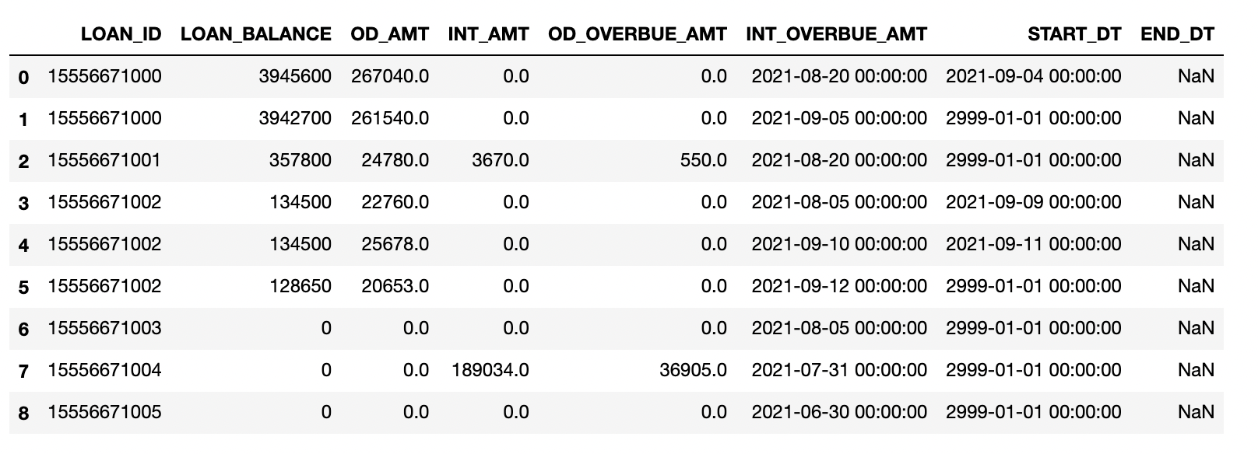
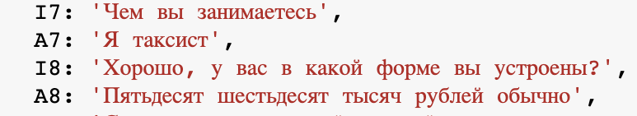
Primary data analysis : relevance for the following use
Postgresql: 2 out of 4 tables can be used
MySQL: 2 table selected
Neo4j: 1 table to be used
Mongodb: data contains serious errors and must be corrected and filtered before use
Unique IDs are absent
Dropout reasons: tables do not contain unique IDs, already repeat application data, contain errors, are not relevant for a specific task
Interview transcript error: question and answer do not match

Slide 7
Data extracted. How do we keep it?
psql
Data Warehouse
Analytics Data Mart
HIVE
MySQL
HDFS
neo4j
Reporting Tools
Analytics
Data Science Algorithms
Mongo
Reporting

Slide 8
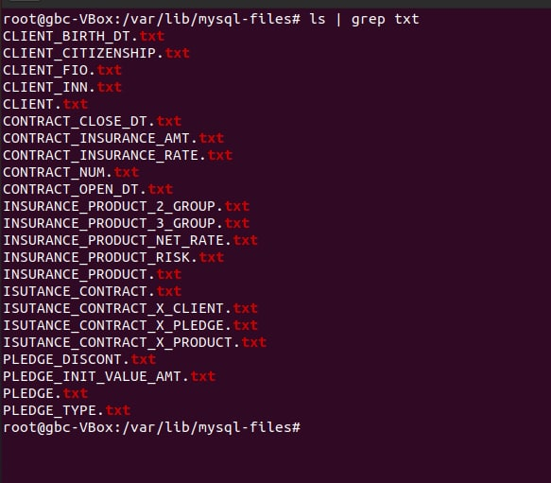

2
Automation of data extraction
Why automation?
The ability to change the scoring system regularly + the bank's obligation to store the data on the basis of which decisions were made.
The data in the databases is systematically updated and corrected. Working directly with the database should be repeated every time the scoring calculation is updated, but the data from which the earlier calculations were made should be stored.
However, if there are many databases, it takes a lot of time and automatic scripts are needed to save it.
Simplified: switching from this to automation

Slide 9
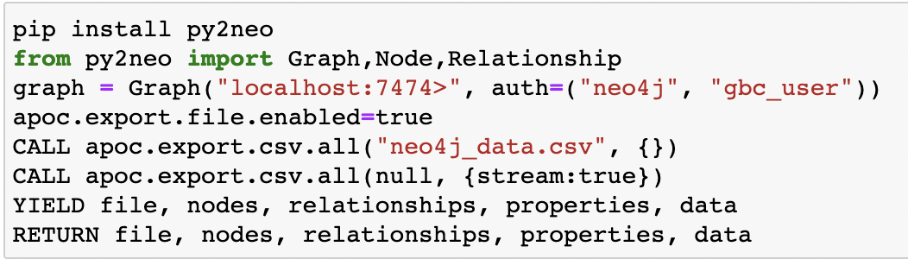

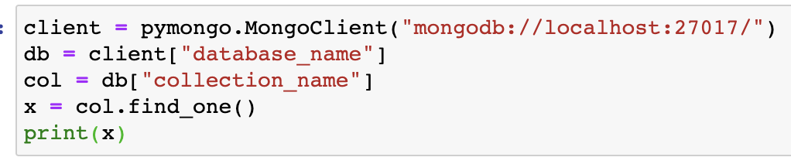


Automation of data extraction: Python3.
import psycopg2
con = psycopg2.connect(
database="postgres",
user="postgres",
password="Kaliakakya",
host="127.0.0.1",
port="5432"
)
print("Database opened successfully")cur = con.cursor()
cur.execute("SELECT admission, name, age, course, department from STUDENT")
rows = cur.fetchall()
for row in rows:
print("ADMISSION =", row[0])
print("NAME =", row[1])
print("AGE =", row[2])
print("COURSE =", row[3])
print("DEPARTMENT =", row[4], "\n")
print("Operation done successfully")
con.close()
: py2neo, Cypher query language and APOC library
: Pymongo
: psycopg2

Slide 10
3
Data filtering and transformation
Python3 using Pandas
Requirements:
Check what data can be removed from the application
Combine the data of the received tables with the headings from the Excel document with database descriptions
Parse non-table files and also combine with headers
Filter out data that one can’t use
Combine data (by the presence of a common ID)

Slide 11
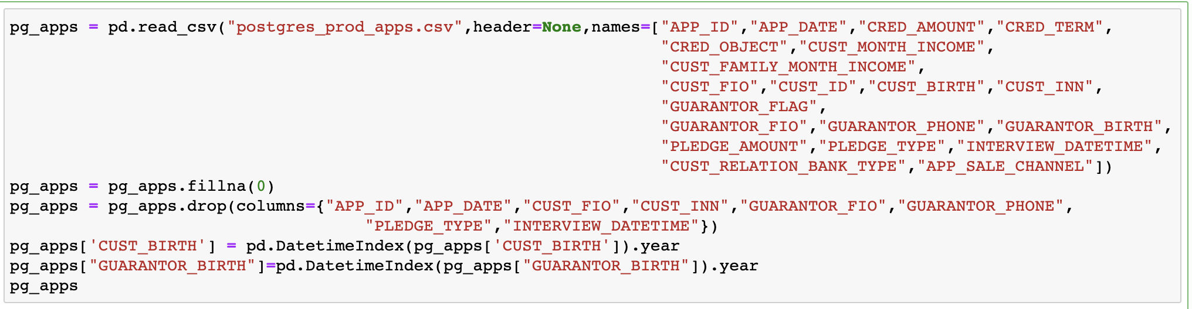
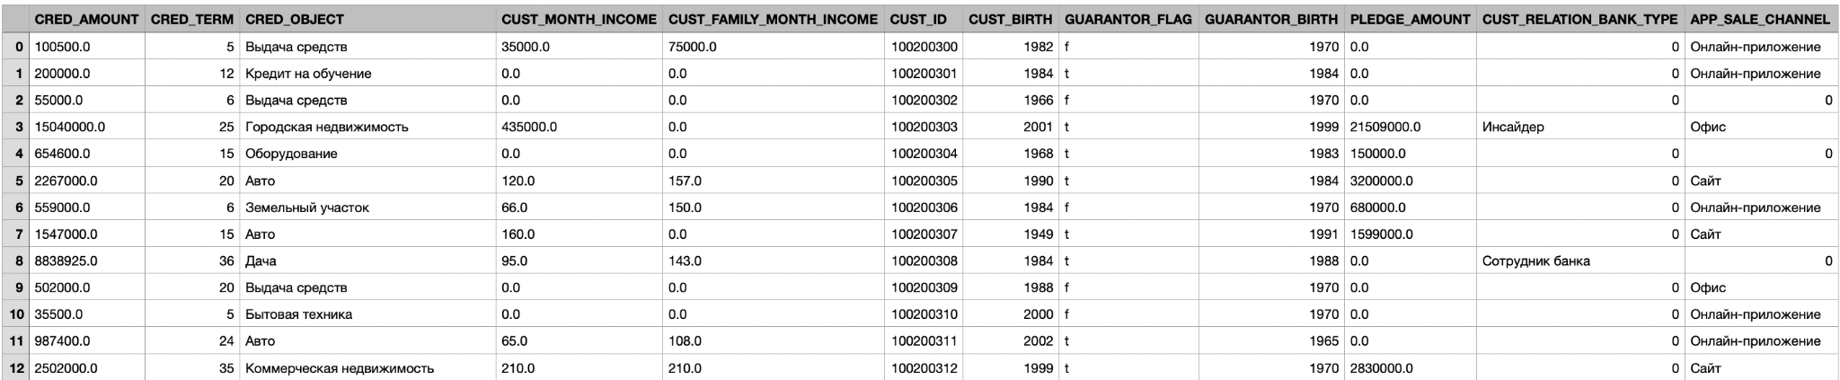
Application processing (Postgresql)
From 20 to 12 columns
Preparing the application for analysis and adding data: adding column names, deleting irrelevant columns for analysis, converting the date of birth to the year of birth, replacing missing values with 0

Slide 12
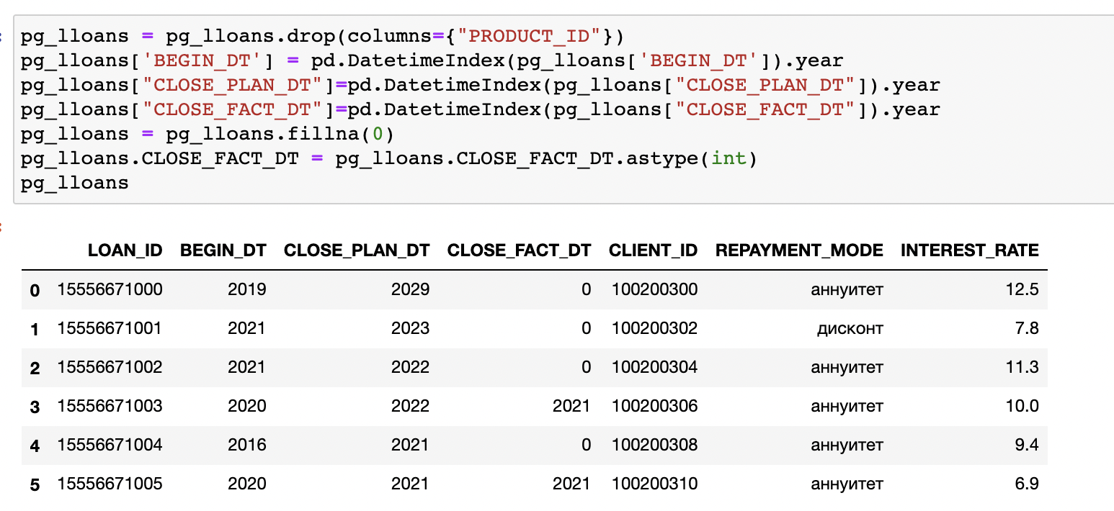
Data filtering and analysis: Postgresql
Preparing for table join

Slide 13
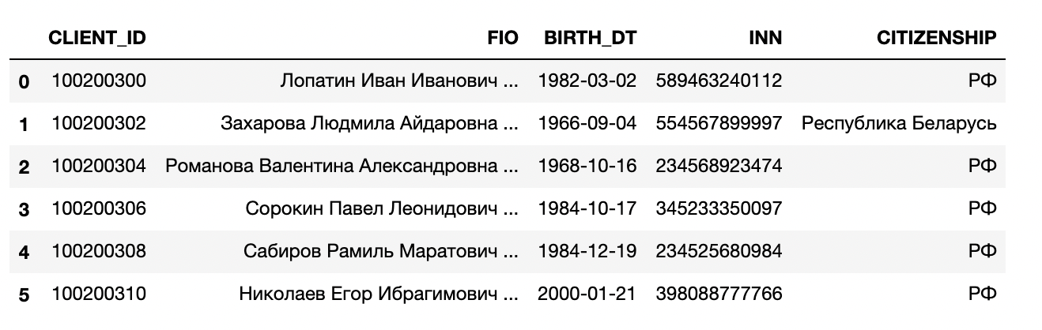
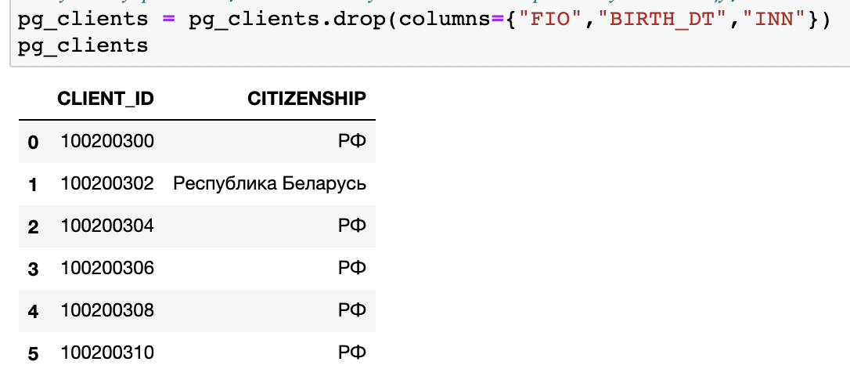
Data filtering and analysis: Postgresql
The table repeats the data from the application, with the exception of citizenship (it can be added to personal data)

Slide 14
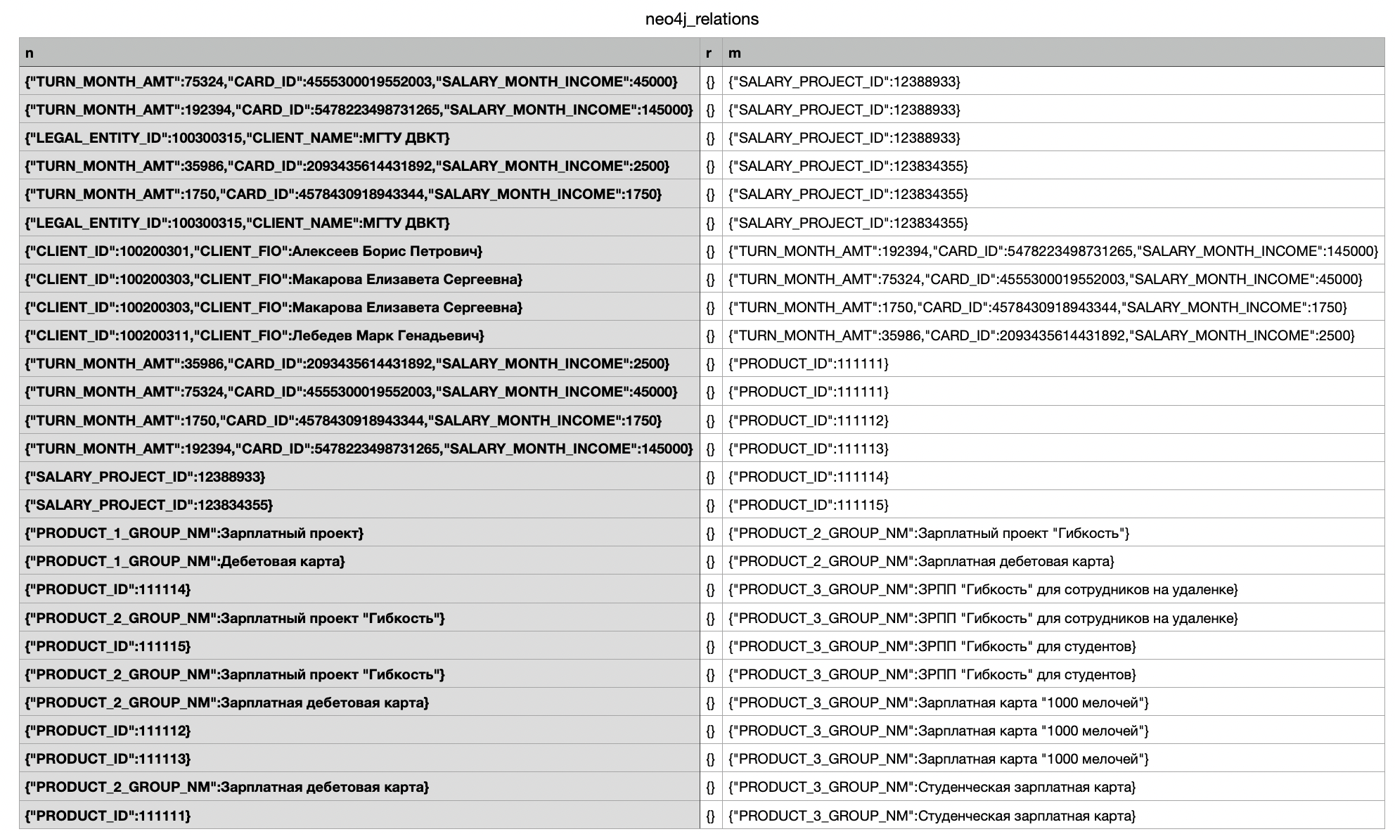
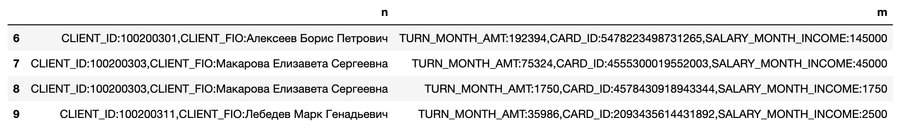
Data extraction and processing: Neo4j
In the beginning
Choosing relevant data for the following analysis

Slide 15
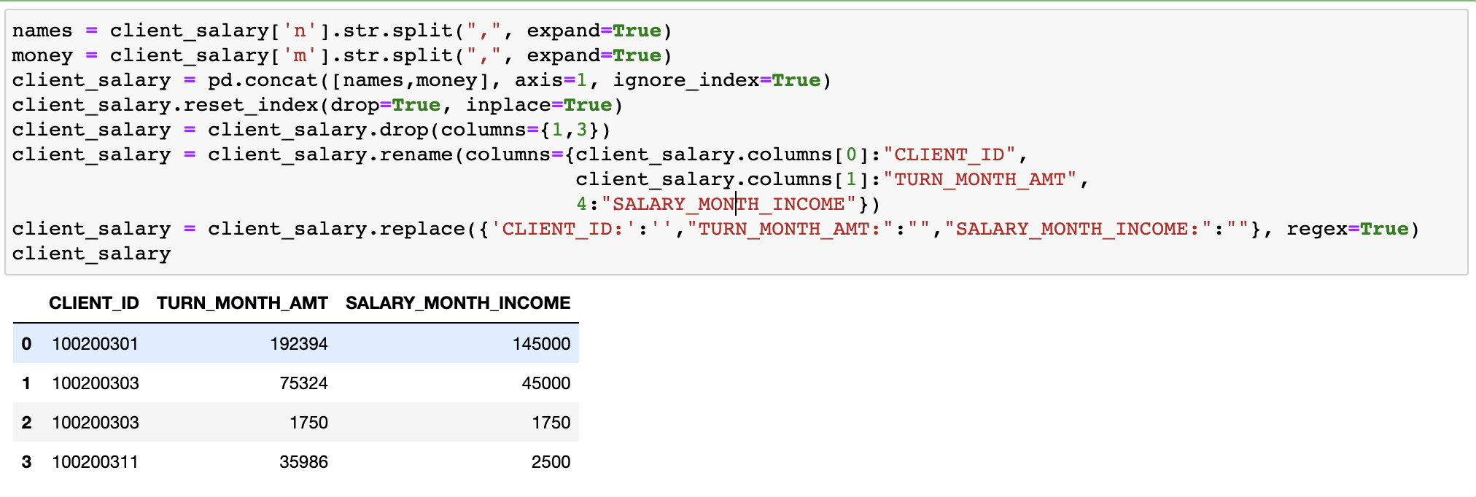
Data processing: Neo4j
Final table ready for join

Slide 16
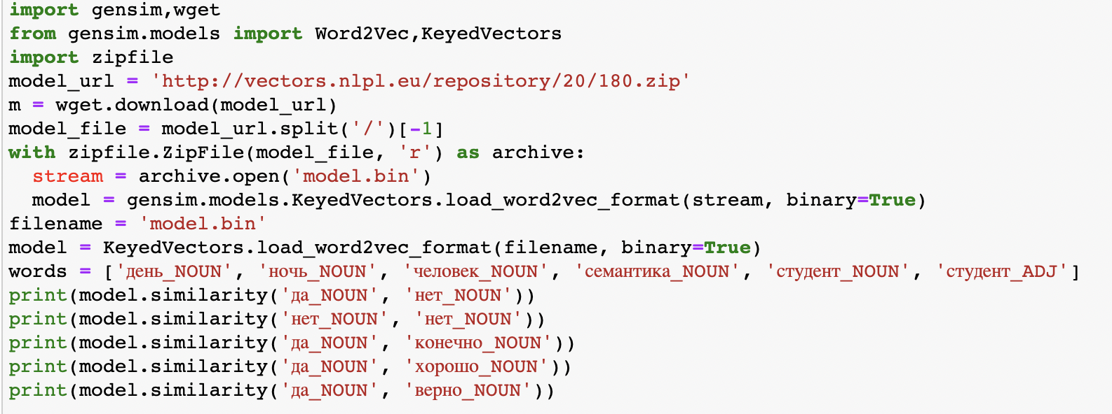
Mongodb: text processing
After correcting errors in the database, one can use it to supplement the application data. For example, by checking if two words match
0.3658021
0.99999994
0.45536008
0.3723208
0.34742245

Slide 17
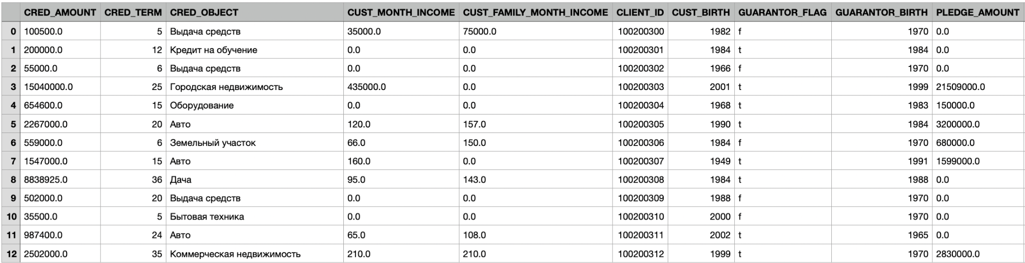
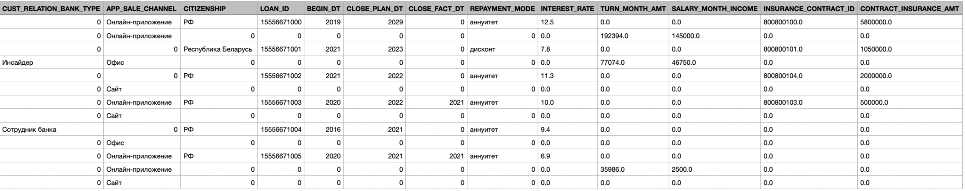
4
Joining data with the application table
Python3 using Pandas
Final filtered table created from Postgresql, MySQL, Neo4j data

Slide 18
5
Identification of parameters significant for creditworthiness from the combined data set
Calculate the significance of the parameters based on the existing payout data, to which algorithms for ML are applied
Data preparation algorithm:
Convert string/object data to numeric (pd.get_dummies)
Select a column with data whose value needs to be predicted (we are interested in data on repayment on time, or on delays)
Apply appropriate algorithm
Get meaningful parameters for the scoring system
Perfect example: Python 3, use sklearn, take Random Forest, GridSearchCV and look at feature_importances_

Slide 19
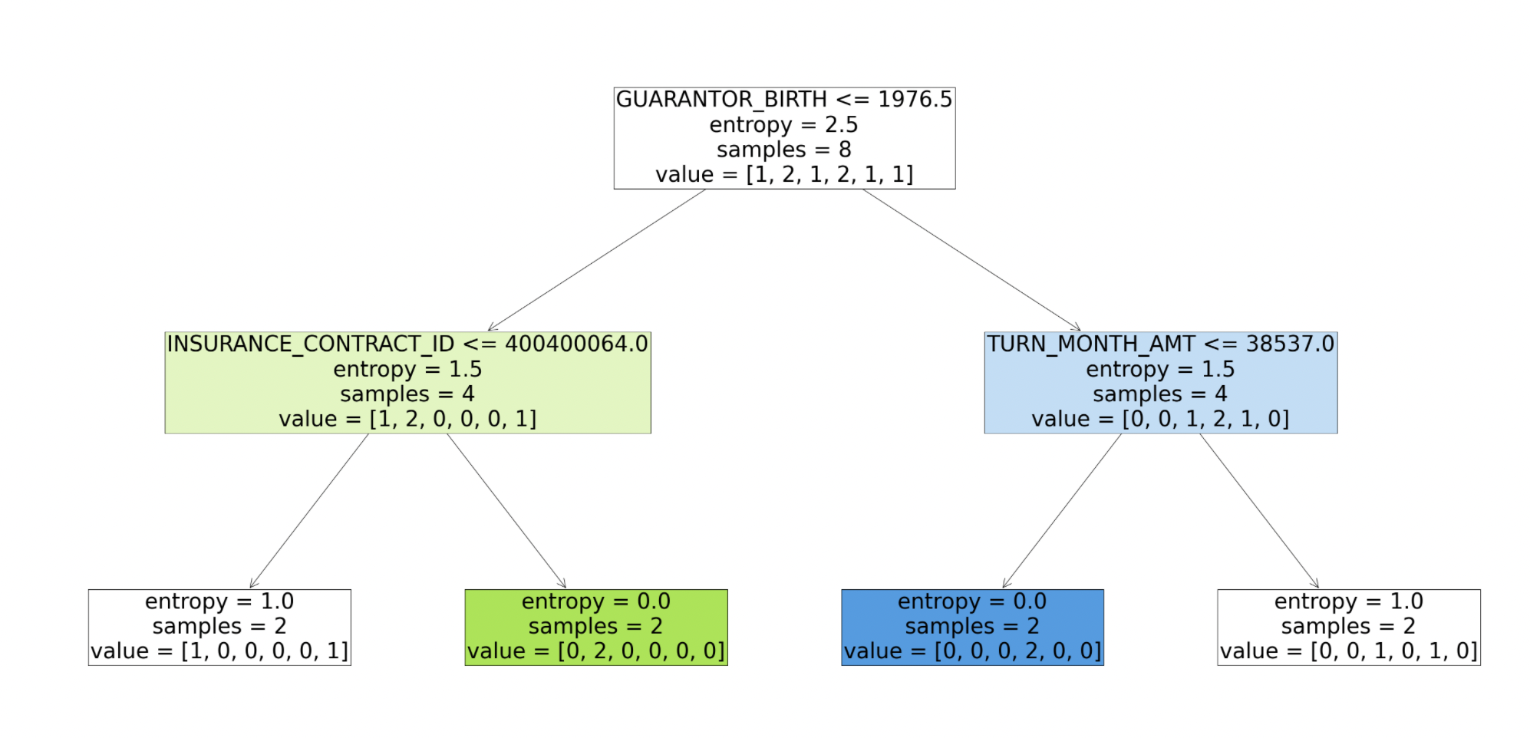
An example of using machine learning:
Classify customers by the loan term using the Decision Tree method (“CRED_TERM” parameter)
(data from the example is not enough to apply Random Forest)

Slide 20
Final product
Takes into account data from different sources
How to apply the product to the marketing goals of the bank?
Significant parameters for customer creditworthiness
May using additional data improve the product?
A list of such parameters can be made publicly available and contribute to a policy of transparency

Slide 21








Roadmap: 1 additional data to improve scoring
Onay C., Öztürk E. A review of credit scoring research in the age of Big Data //Journal of Financial Regulation and Compliance. – 2018.
Work details
Other credits
Financial obligations and fines
Property
Health
etc….

Slide 22


Roadmap: 2 adding a point system after the green flag
Abellán J., Castellano J. G. A comparative study on base classifiers in ensemble methods for credit scoring //Expert systems with applications. – 2017. – Т. 73. – С. 1-10.
Employment history
If these parameters matter, bank has options to e.g. increase insurance for dangerous professions
Has a job
Points +++
How dangerous is the job?
Job details
Points +++

Slide 23
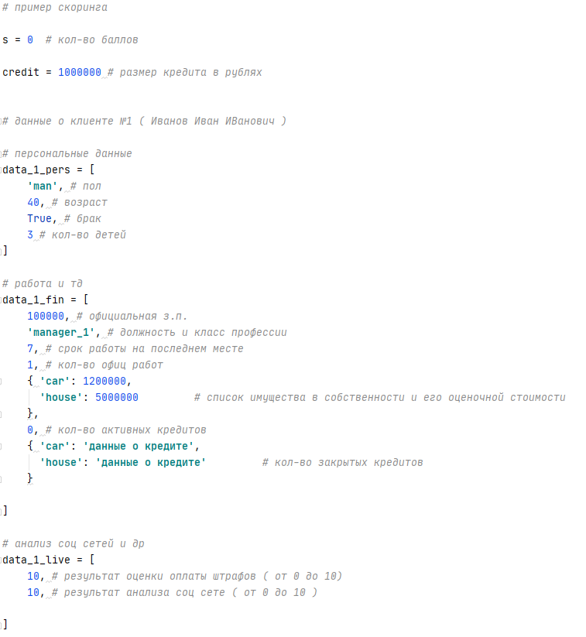
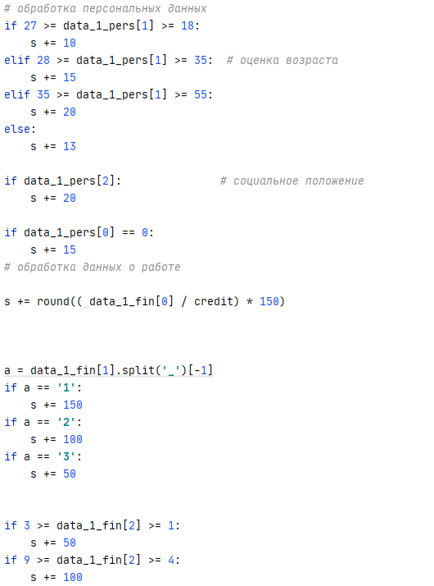
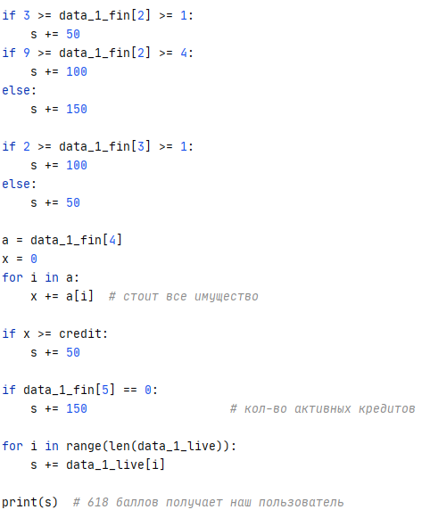
Implementing the point system

Slide 24
Roadmap 3: change in primary scoring based on literature data, after analysis
Albareto G., Felici R., Sette E. Does credit scoring improve the selection of borrowers and credit quality? //Bank of Italy Temi di Discussione (Working Paper) No. – 2016. – Т. 1090.
Before
After
< 1 year +
1-5 years ++
>5 years +++
< 1 year ++
1-5 years ++
>5 years +
governmental ++
commercial +
governmental +
commercial +++
Job details
Teacher, manager +++
Driver ++
Firefighter +
Teacher, manager +
Driver +
Firefighter ++

Slide 25



Current marketing offer
Mortgage from Catbank
Luxury?!
I wish I could afford a studio!
Central Moscow, luxury five bedroom apt!

Slide 26

Marketing #1 – different borrower category
Marketing #2 governmental programs
Clustering of borrowers by selected parameters (profession, expense categories, age, etc.)
Different offers for those who fail to pay on time, and those who don’t
https://programs.gov.ru
For:
Young families
Large families
Military workers
Scientists
Goals:
New buildings
Agriculture
Hectare and distant lands

Slide 27

Individual marketing offer
SMS: Dear cat Vasily! Catbank offers you a mortgage for a pretty studio, we can approve you a loan without a down payment!
Meow!! I take it!

Slide 28





Our team
Maria Zelenova
Dmitriy Prudii
Kirill Vasin
Georgiy Krasavin
You can contact us:
maria_zelenova@yahoo.com

Slide 29

Thanks for your attention!
They teach machines, but will a machine pet me?!
Whiskers, paws and tail - my ability to pay!

